Slide 1
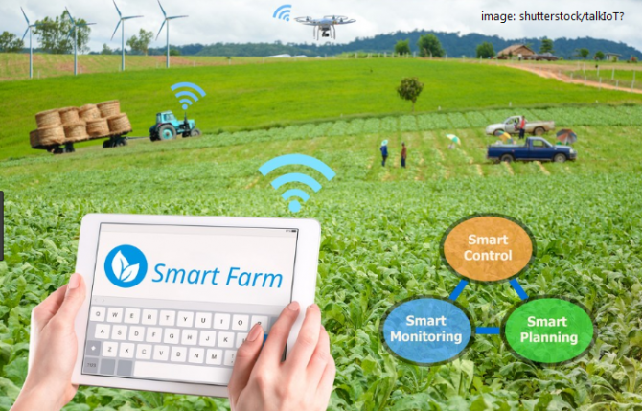

SMART IOT NETWORKING IN AGRICULTURE
Presented by, Group 4

Slide 2



INTRODUCTION
Gafrilatif Aviandi Putra Adnanta
Project Member
Muhammad Zidan Satrio
Project Leader
Muhamad Farhan Budiana
Project Member

Slide 3
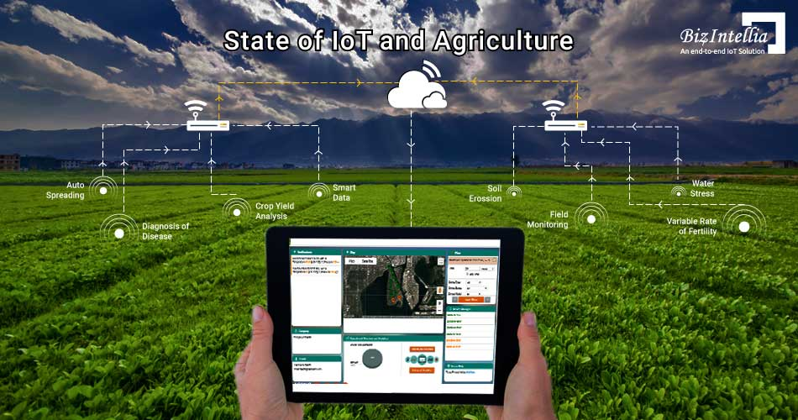
TABLE OF CONTENTS
System Analysis
IP Table
Network Topology
Components
Network Configurations
Output

Slide 4
SYSTEM ANALYSIS
This project describes how to use Cisco Packet Tracer. Cisco Packet Tracer is a cross-platform visual simulation tool designed by Cisco Systems that allows users to create network topologies and imitate modern computer networks.
The Internet of Things (IoT) describes the network of physical objects – a.k.a. “things” – that are embedded with sensor, software, and other technologies for the purpose of connecting and exchanging data with other devices and systems over the internet. For example our project will be the example of Smart IoT Networking on Agriculture.

Slide 5
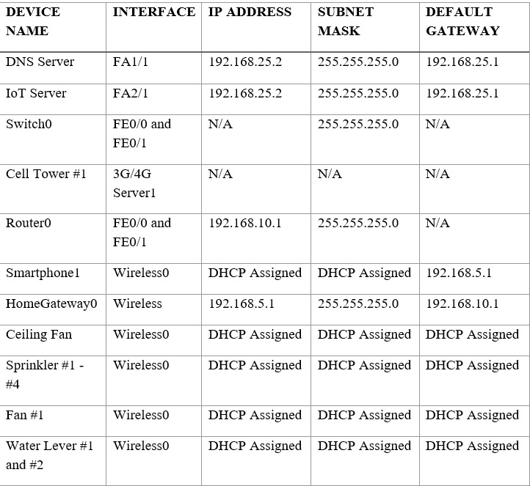
IP TABLE

Slide 6
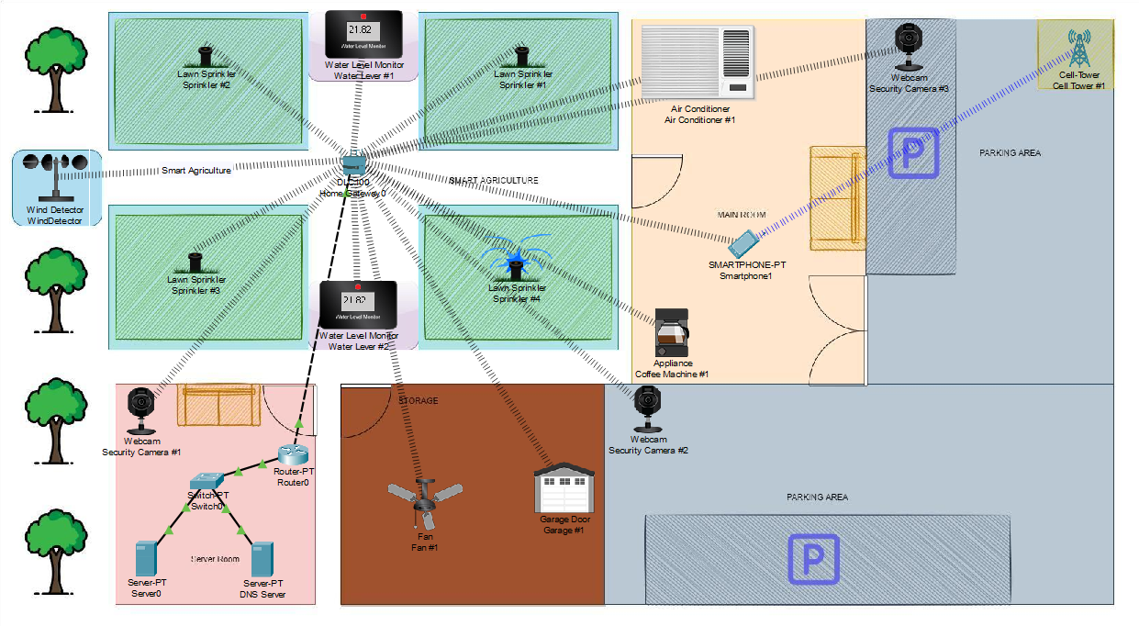
NETWORK TOPOLOGY

Slide 7



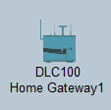



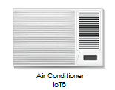
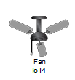




COMPONENTS
Server
Switch
Router
DLC100
Smartphone
Security Camera
Wind Detector
Air Conditioner
Fan
Garage Door
Coffee Maker
Water Level Monitor
Lawn Sprinkler

Slide 8
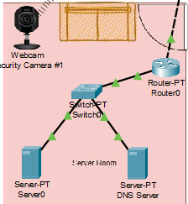
NETWORK CONFIGURATIONS

Slide 9
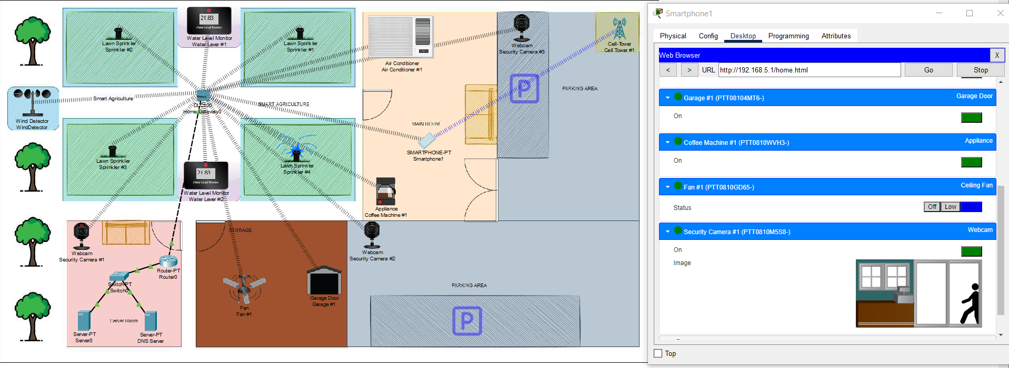
OUTPUT

Slide 10

THANK YOU!

